Slide 1
Psychokinesis & color
Jacob Fiola
ECEN 3070
Edges of Science

Slide 2

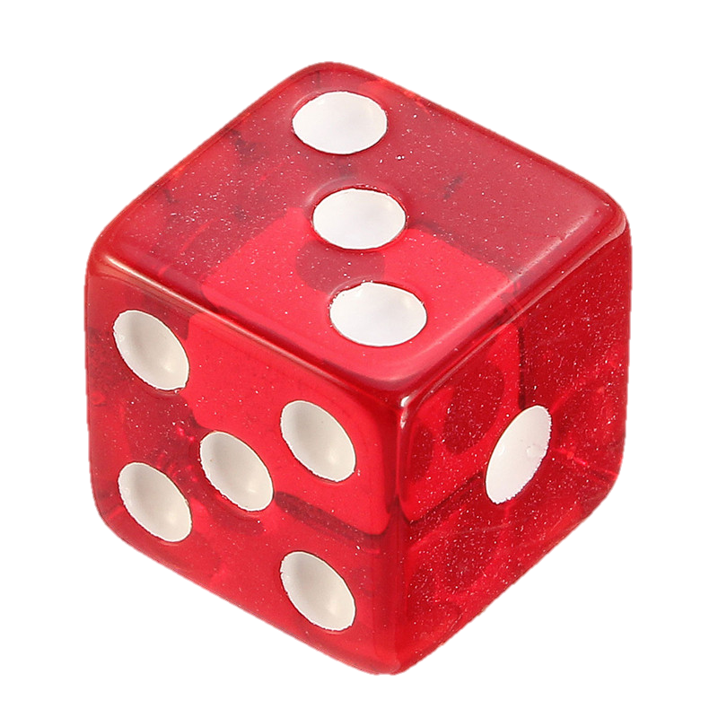
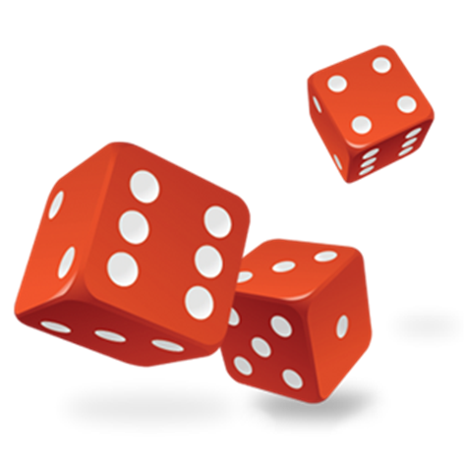
Motivation
Lim
NDice->∞?
Notes:
Radin and Nelson argued that ff the mind influences each die in approximately the same way, then our ability to detect that PK effect ought to improve as we toss more dice at once.
So, if I were a rather psychokinetic person, then the effect size of my psychokinesis would increase as the amount of dice increases.
Would I be able to test this behavior on a computer?

Slide 3

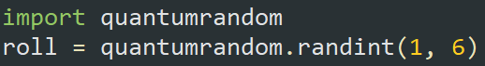
Motivation
5.7m true quantum rolls/sec!!
Python makes it as easy as…
How does psychokinesis behave when NumRolls becomes huge?
How can I make an experiment that takes advantage of this rolling power?
Notes:
Because if I could test this behavior on a computer, then I would have more tools understand psychokinesis to a finer degree. Specifically, I would be able to see how psychokinesis may or may not effect large quantities of data
There was a

Slide 4
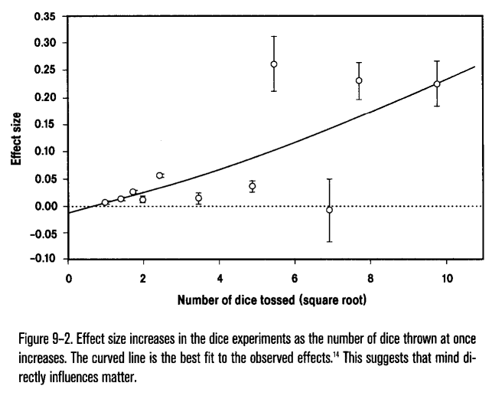
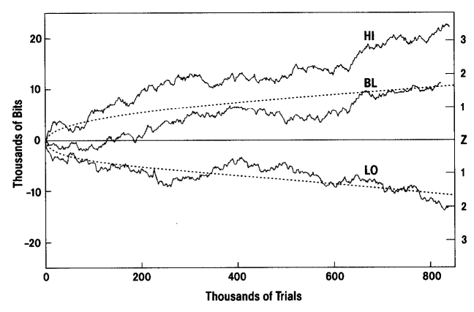
Background Literature
Radin & Nelson– Mind-Matter Interaction
Radin, D. I., and R. D. Nelson. "Meta-analysis of mind-matter interaction experiments: 1959-2000." Healing, Intention and Energy Medicine. London: Harcourt Health Sciences (2003): 39-48.
Notes:
There have been a few past trials which have also focused on what I’m interested on.
First off was Radin and Nelson’s extensive meta-analysis, which attempted to study the effect I was mentioning earlier.
Their data suggested that mind directly influenced matter.
Later on in the same paper, Radin and Nelson continue to study this phenomenon, but on the computer instead of with dice this time.
To me, it seems as though the effect somewhat translated over to RNGs instead of matter itself.
When I saw that the effect could maybe manifest in computer testing, I knew I had the green light to make my own program which tested it.

Slide 5
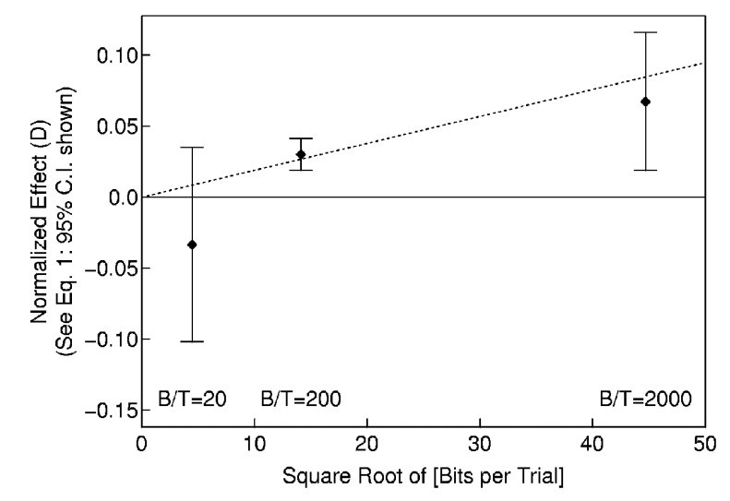
Background Literature
The MegaREG Experiment: Replication and Interpretation
Dobyns, Y. H., et al. "The MegaREG experiment: Replication and interpretation." Journal of Scientific Exploration 18.3 (2004): 369-397.
Notes:
Furthermore, this thing called the MegaREG experiment gave me even more confidence.
These guys really drove home the connection between “dice per roll” and “bits per trial”.
The two are very synonymous.
So although it may be true that mind directly influences matter by volume, mind may also directly influence RNG by volume.
However, interestingly enough, when these guys went full “megamega REG”, they actually found a reversal of the psi effect, which led to some pretty inconclusive results.

Slide 6

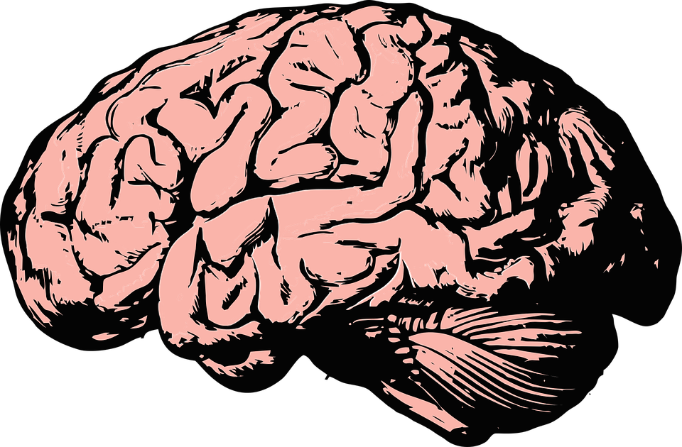

Experimental Methods
Psi-influenced numbers
Participants attempt to cluster the numbers towards some specific value.
Control numbers
No participants are present, computer generates a bunch of random numbers.
Average distance from psi value?
Statistically significant difference? (p value <.05?)
Notes:
So what I wanted to do was compare two huge sets of data.
One set would be the results of “psi-influenced” random numbers, and the other set would be my control, AKA, just a bunch of random numbers that I told the computer to get.
I would then cross-reference these two datasets to look for any differences.

Slide 7
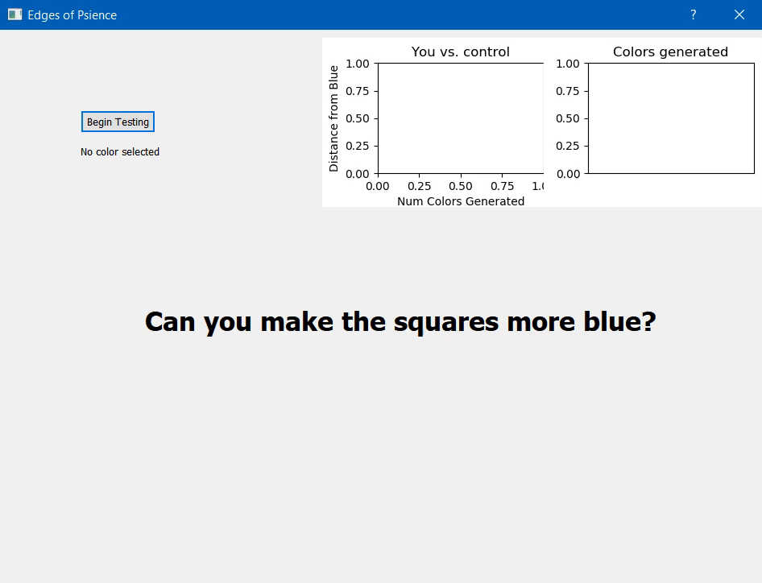
Demo
Notes:
So let me show you exactly how I gathered that data from the participants…

Slide 8

Data + Analysis
30 Participants
30*(391 each) = 11,730 colors generated
Avg. of 423.10 distance from “blue” (TECHNICALLY BEAT THE COMPUTER!)
Control
3,485,726,894 colors generated in 30 seconds.
Very distributed
Avg. of 424.40 distance from “blue”
P value of 0.3807, though…

Slide 9
Conclusions
Null hypothesis supported.
There is still hope!
Consistency in replication?

Slide 10
Questions?

